Slide 1
Core data 44643 mobile Computing – iOS
Instructor: Dr. Chandra Mouli
Northwest Missouri State University

Slide 2
Table of contents
Introduction
Core Data Stack
Working with Core Data in Xcode
Fetch, create, delete and update
Save context
Conclusion

Slide 3
Introduction
Core Data framework.
Persist or cache data on a single device, or sync data to multiple devices with CloudKit.
Persistence feature of Core Data.
Core Data abstracts the details of mapping your objects to a store, making it easy to save data without administering a database directly.
Other features include undo and redo of individual or batched changes, background data tasks, view sync (table views and collection views), and versioning and migration.

Slide 4

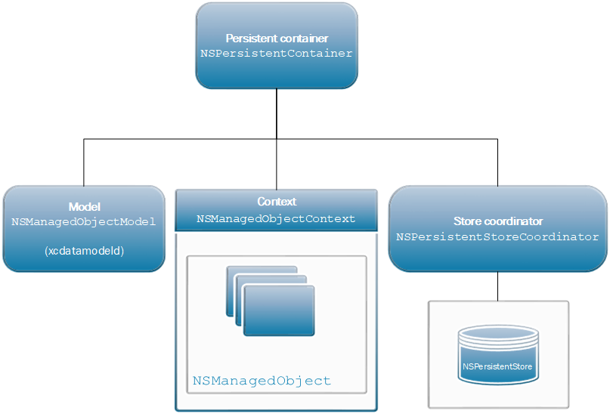
Core data stack

Slide 5
Core data stack
An instance of NSManagedObjectModel represents your app’s model file describing your app’s types, properties, and relationships.
An instance of NSManagedObjectContext tracks changes to instances of your app’s types.
An instance of NSPersistentStoreCoordinator saves and fetches instances of your app’s types from stores.
An instance of NSPersistentContainer sets up the model, context, and store coordinator all at once.

Slide 6

Core data in xcode

Slide 7
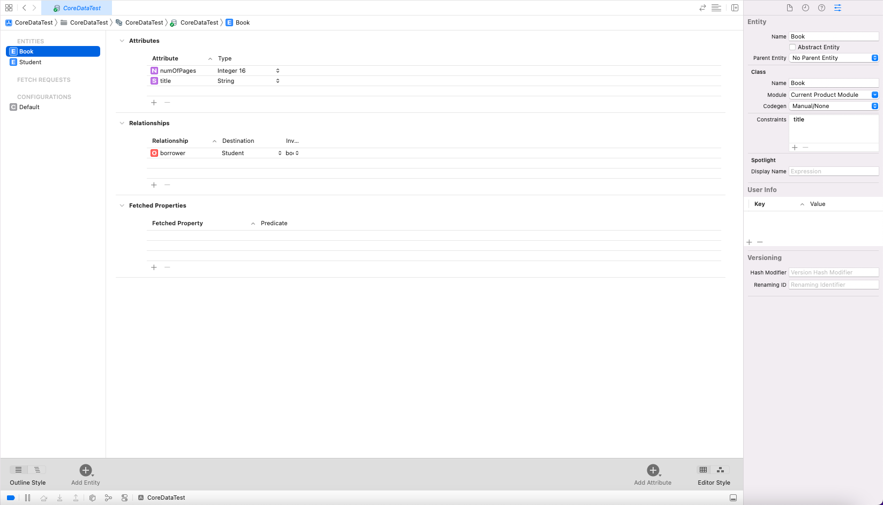
Book entity
1
3
2
Add an entity
Graphical view

Slide 8
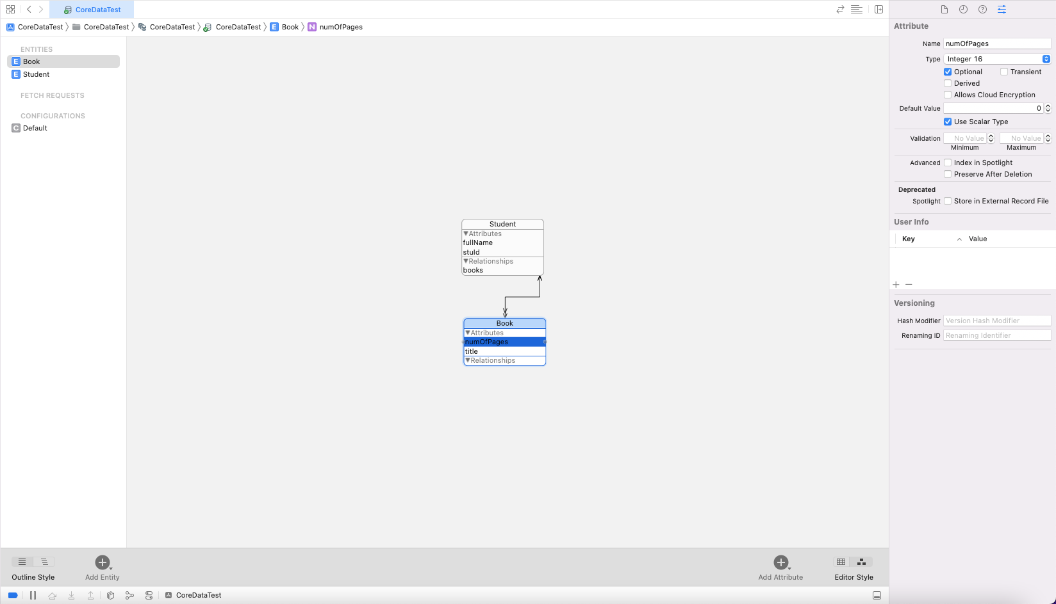

Slide 9
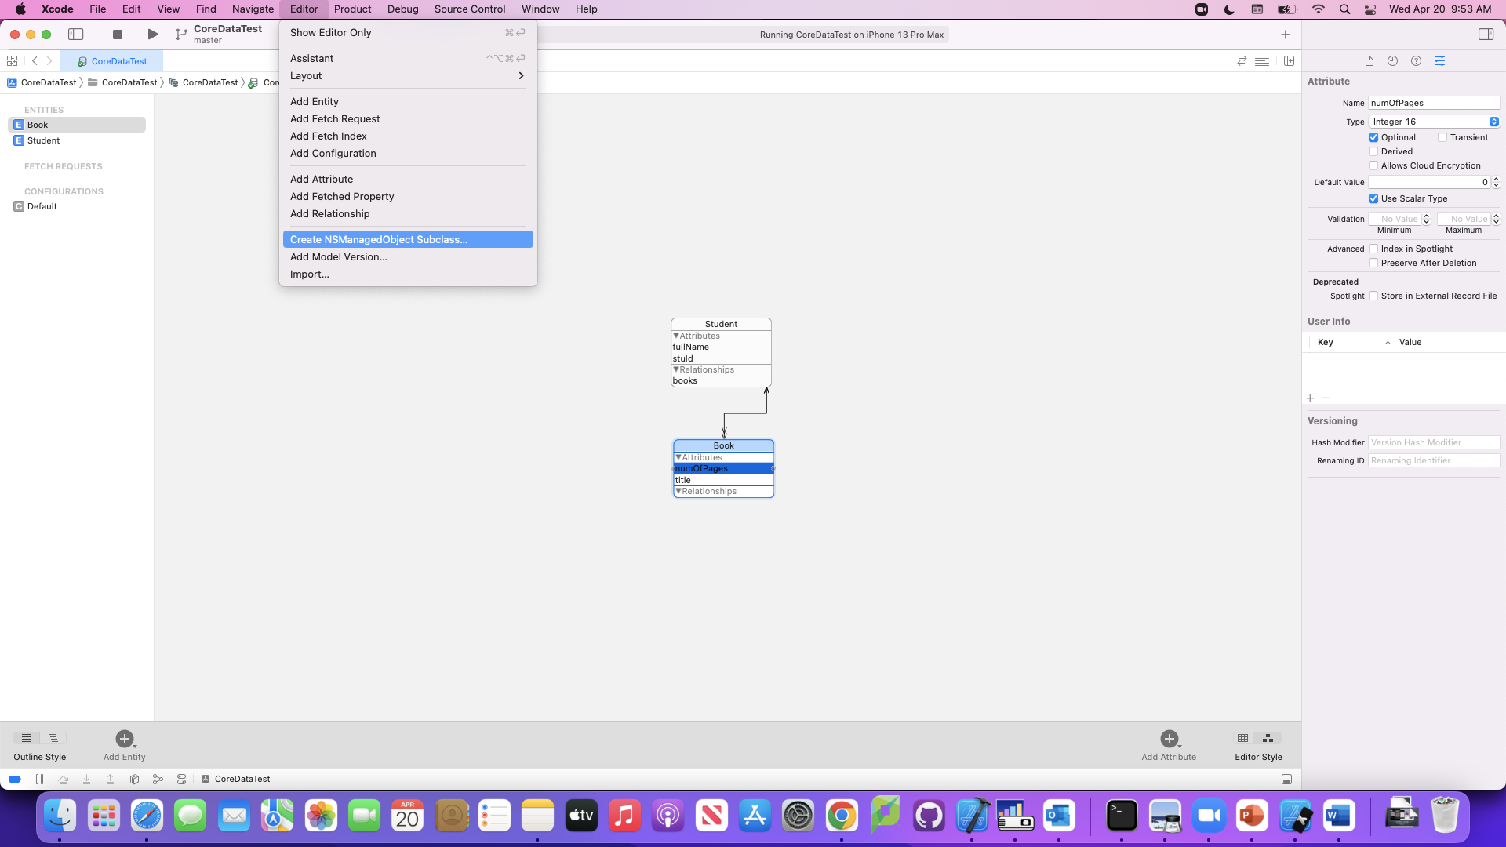

Slide 10
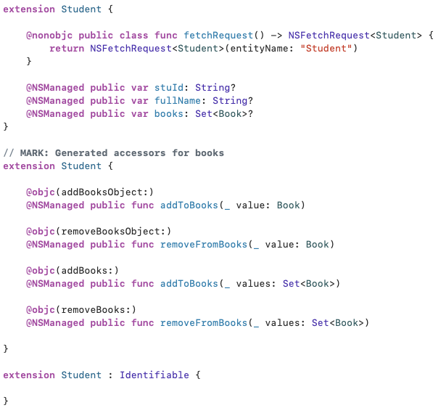
Class Student

Slide 11
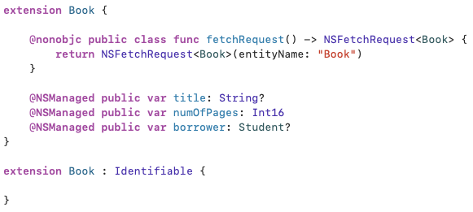
Class Book

Slide 12
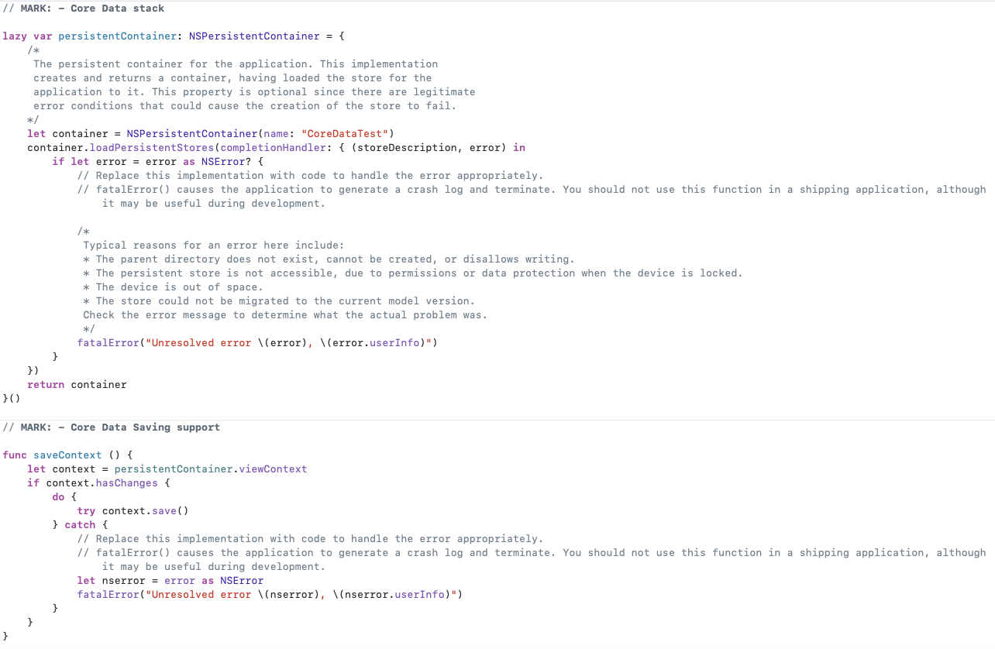
contained in AppDelegate class

Slide 13
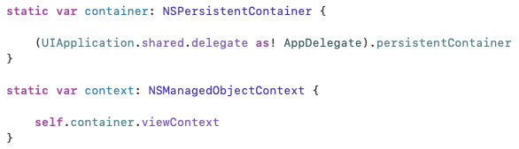
PersistentContainer & Context
Add two important type variables in AppDelegate class.

Slide 14

Fetching
In general, we need to create a fetch request, if needed, provide sort descriptors and predicate it.

Slide 15
fetching
fetchResultController = NSFetchedResultsController(
fetchRequest: request,
managedObjectContext: AppDelegate.context,
sectionNameKeyPath: nil,
cacheName: nil)
try fetchResultController?.performFetch()

Slide 16

create
To create a record for an entity in the database, use the entity’s initializer that takes a context parameter of type NSManagedObjectContext.
For example,
AppDelegate.context

Slide 17
Delete & update
To delete
AppDelegate.context.delete(someObject)
To update
Fetch the object from database and assign new values to its properties.

Slide 18
Save
To save any changes you made into the persistent store.
try? AppDelegate.context.save()

Slide 19
Conclusion
Use Core Data to save your application’s permanent data for offline use, to cache temporary data, and to add undo functionality to your app on a single device.

Slide 20
reference
https://developer.apple.com/documentation/coredata

Slide 21
Core data 44643 mobile Computing – iOS
Instructor: Dr. Chandra Mouli
Northwest Missouri State University

